Slide 1
LIFE FAIR!
CELEBRATE THE
GIFT OF LIFE!

Slide 2
LET US SHARE OUR PRO-LIFE RESOURCES WITH YOU!

Slide 3
What is it?
A home grown, grass roots effort to share important information on life issues while celebrating the beauty of God’s great gift of life!

Slide 4
Why hold a Life Fair?
Build a Culture of Life
Educate and Celebrate
Encourage and Motivate

Slide 5
What is included?
Posters
Literature
Games/Prizes
Give-aways

Slide 6
What are the Topics?
The topics include:
Human Development
Abortion
Pregnancy Help
Post-Abortion Healing
Contraception/NFP
Chastity
Euthanasia/Assisted Suicide

Slide 7
How Much Does It Cost?
Nothing.

Slide 8
Where is it held?
Parishes
Schools
Religious Education Classes
Other Events

Slide 9
How much room is needed?
Size and content are determined by those holding the event.

Slide 10
How can we hold a Life Fair?
Share Life Fair details with your parish or school.
Set a date.
Be a contact when we arrive with the materials, set-up and run the event.

Slide 11
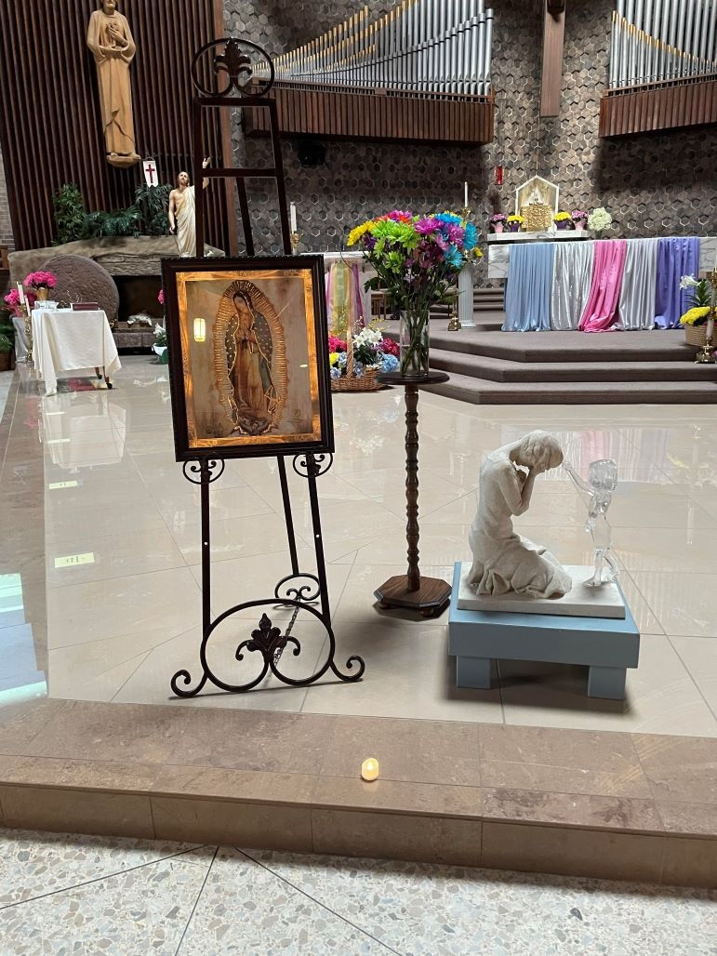
Other Associated Elements
Prayer service
Videos
Speaker
Diaper drive

Slide 12
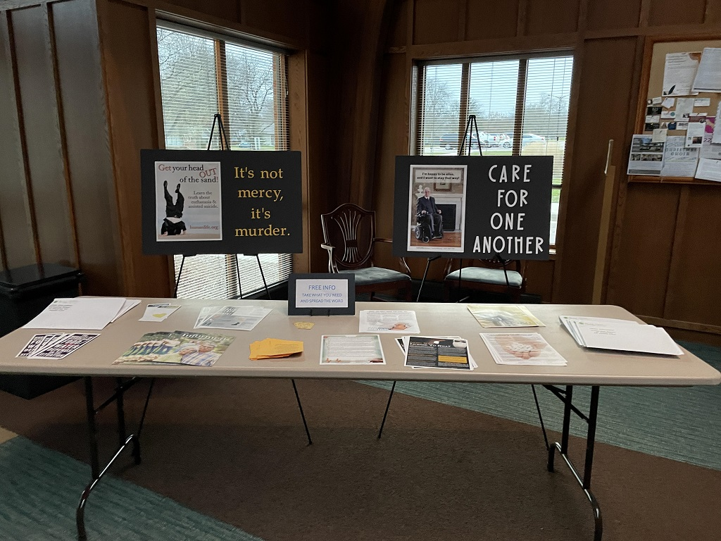
Other Ways to Share
Request materials to use.

Slide 13
Ways to Help
Interested in supporting
this effort?
Join the Life Fair Brigade
Sponsor a Life Fair

Slide 14
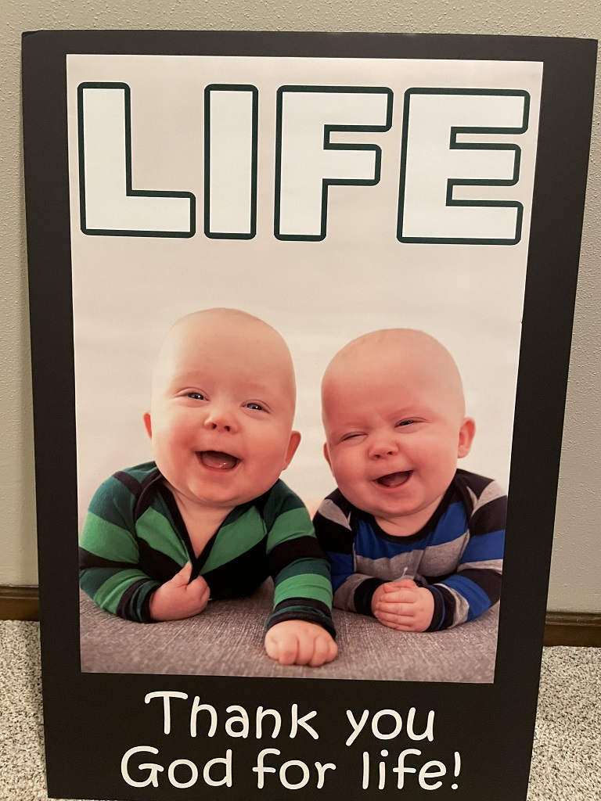
POSTERS

Slide 15
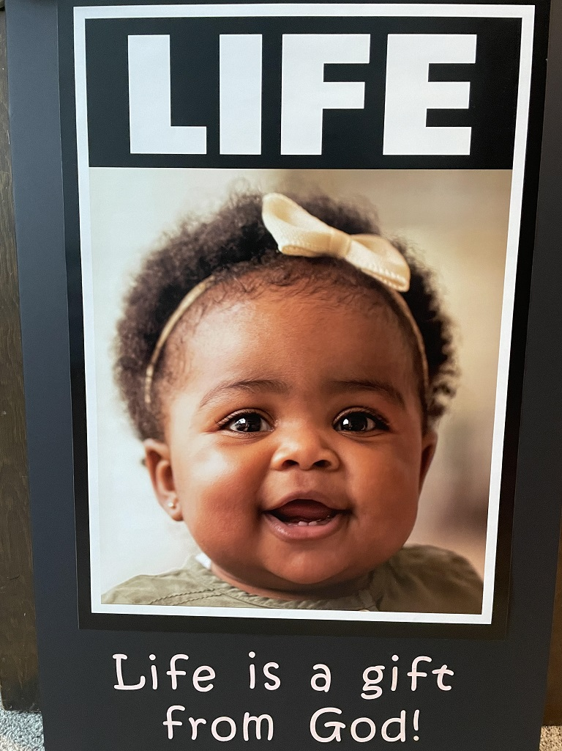


Slide 16

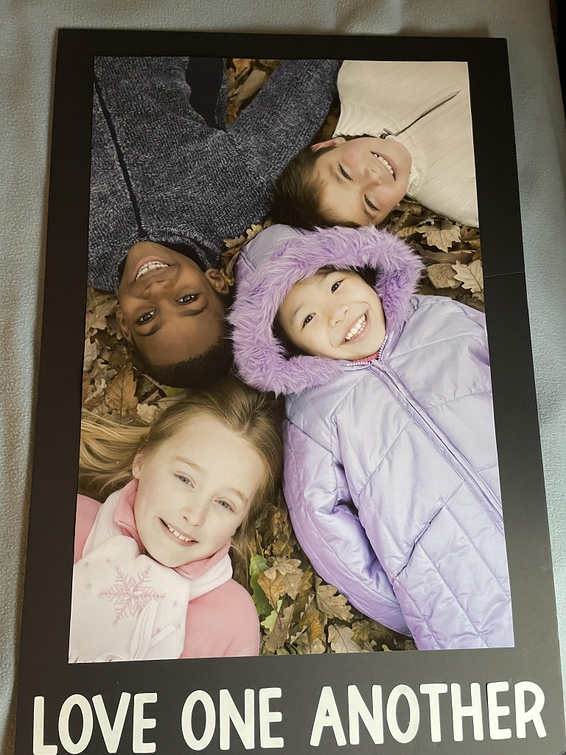

Slide 17
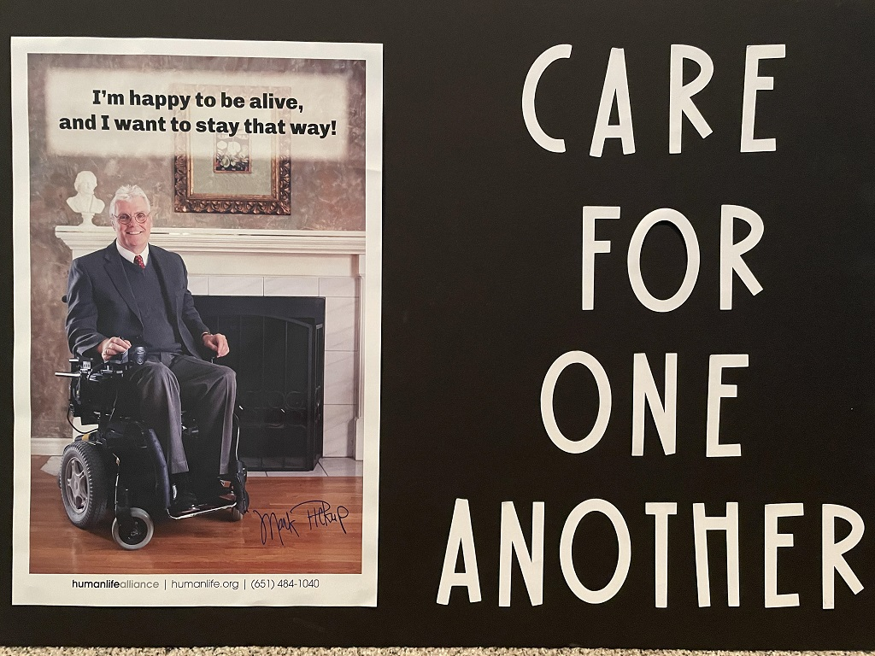

Slide 18
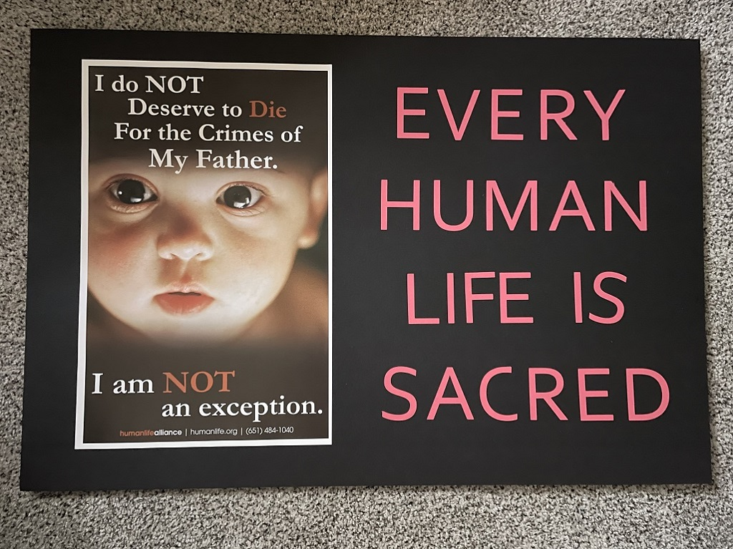


Slide 19

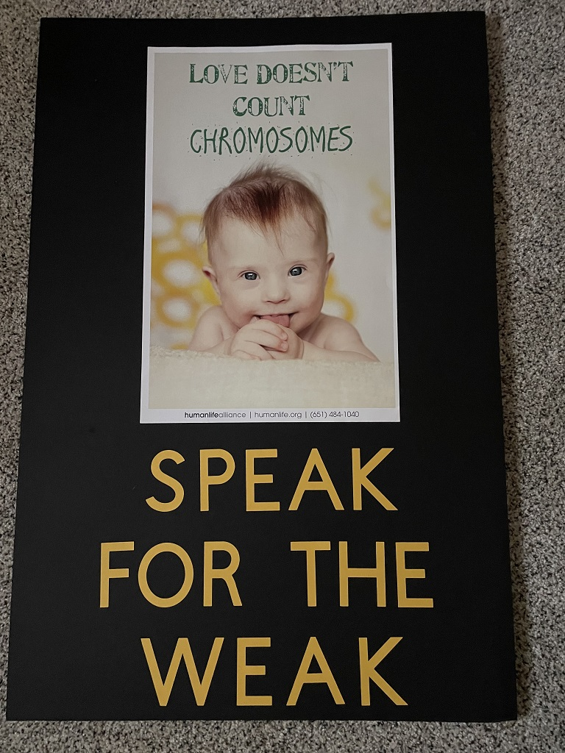

Slide 20
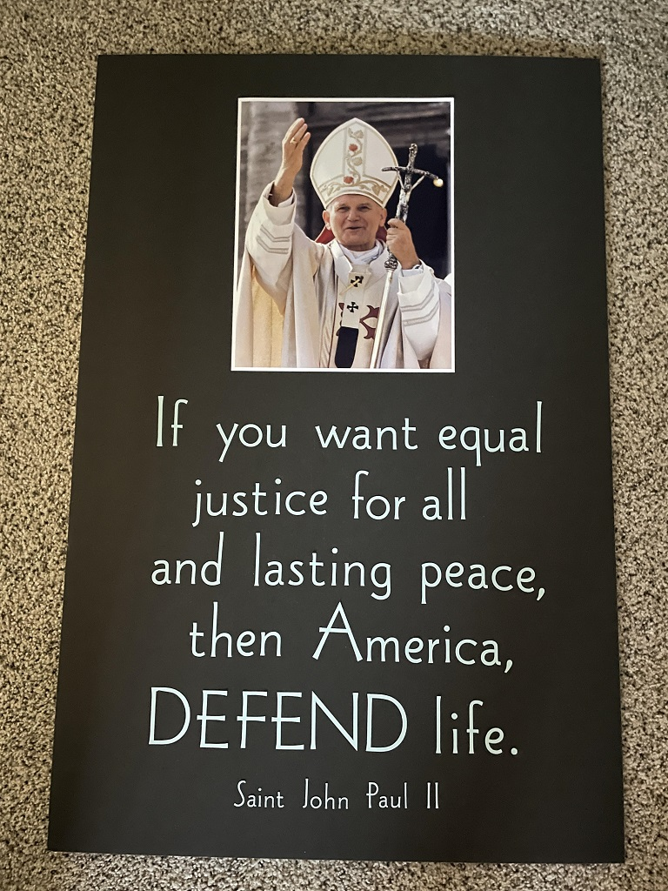

Slide 21
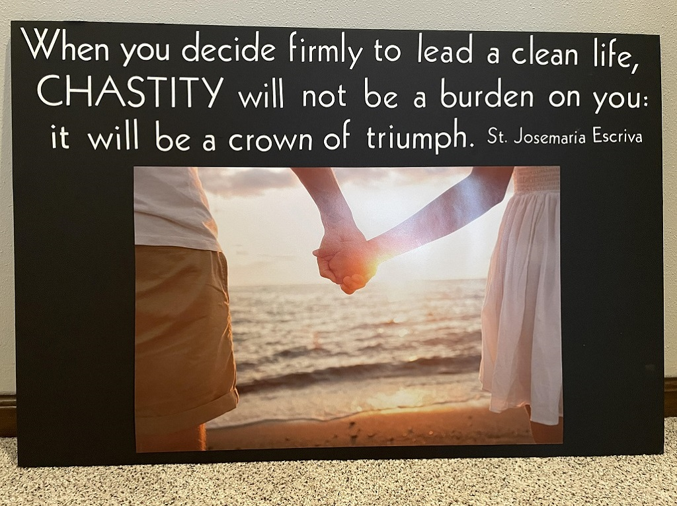

Slide 22
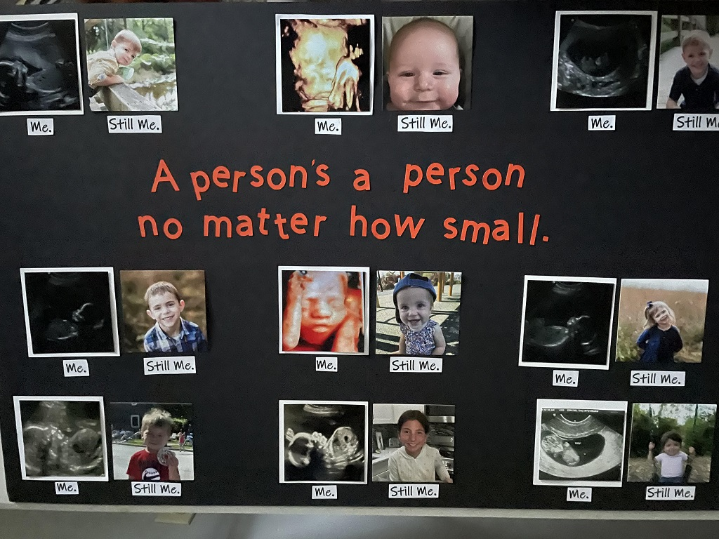

Slide 23


Slide 24



Slide 25
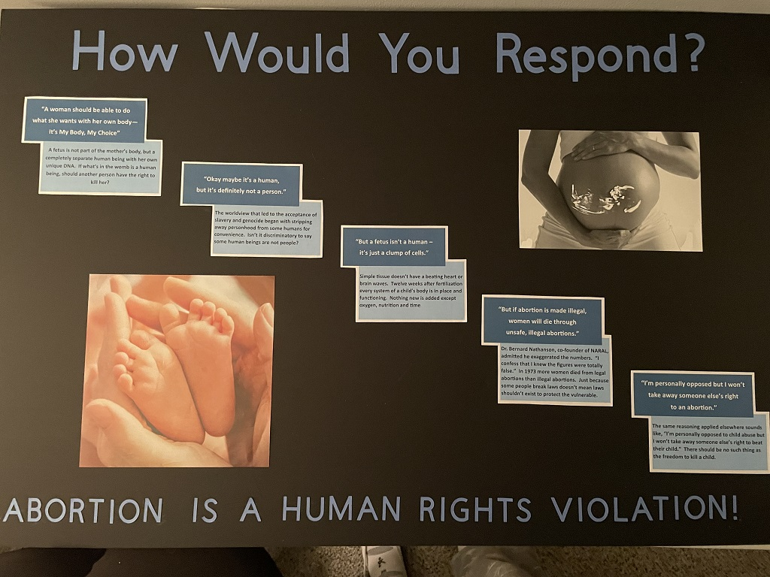

Slide 26
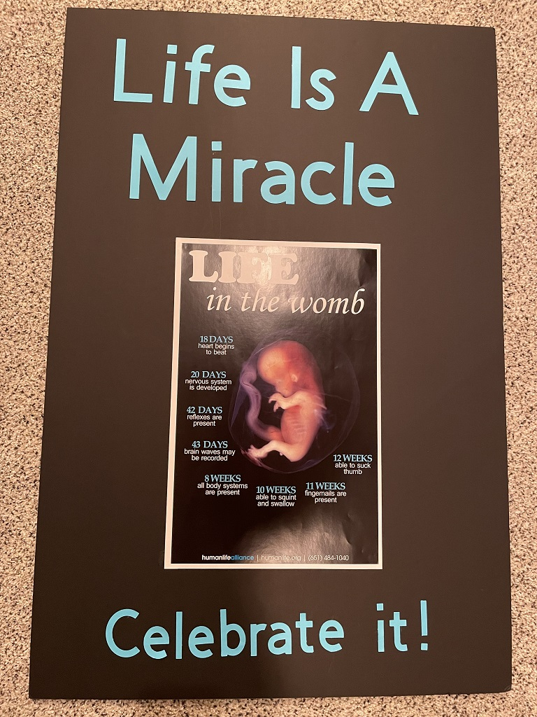

Slide 27


Slide 28

LITERATURE

Slide 29
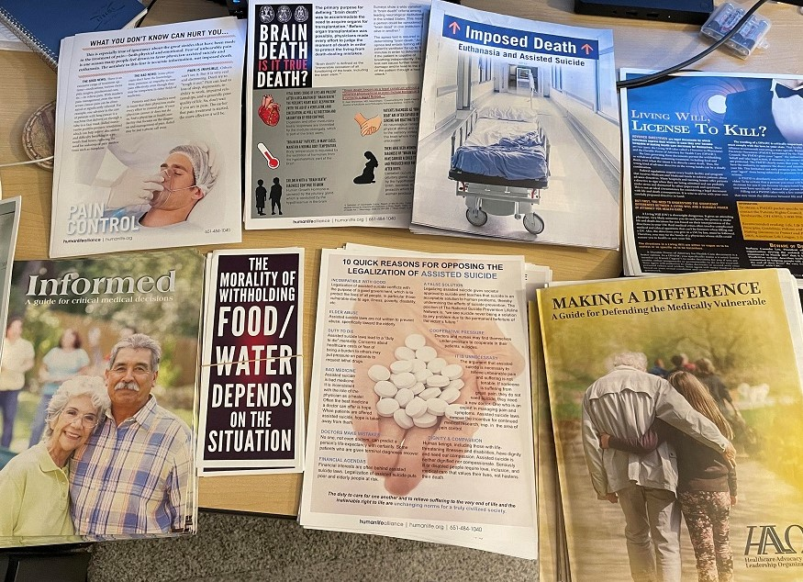

Slide 30
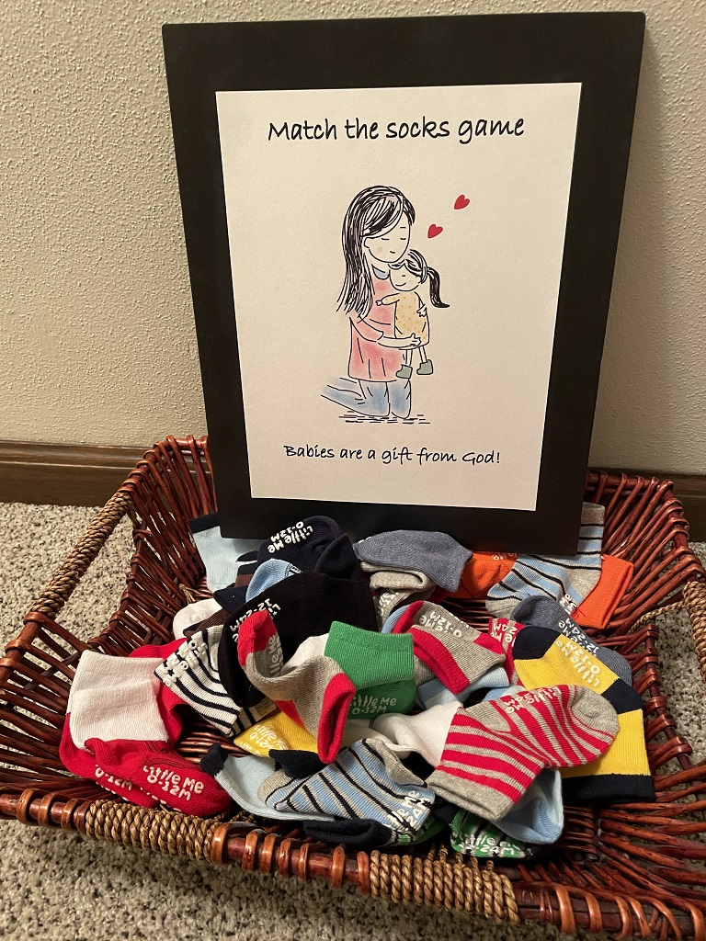
GAMES
MATCH THE SOCKS

Slide 31
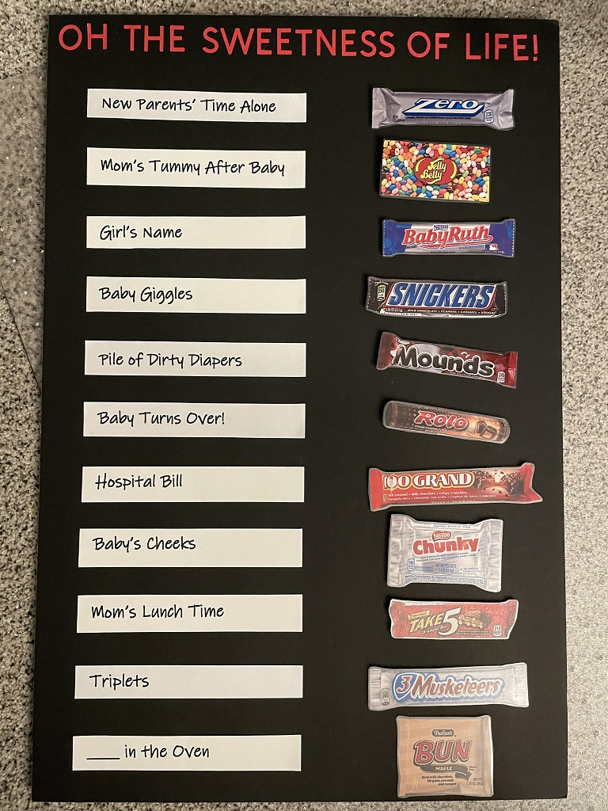
TASTE THE SWEETNESS
OF LIFE!

Slide 32
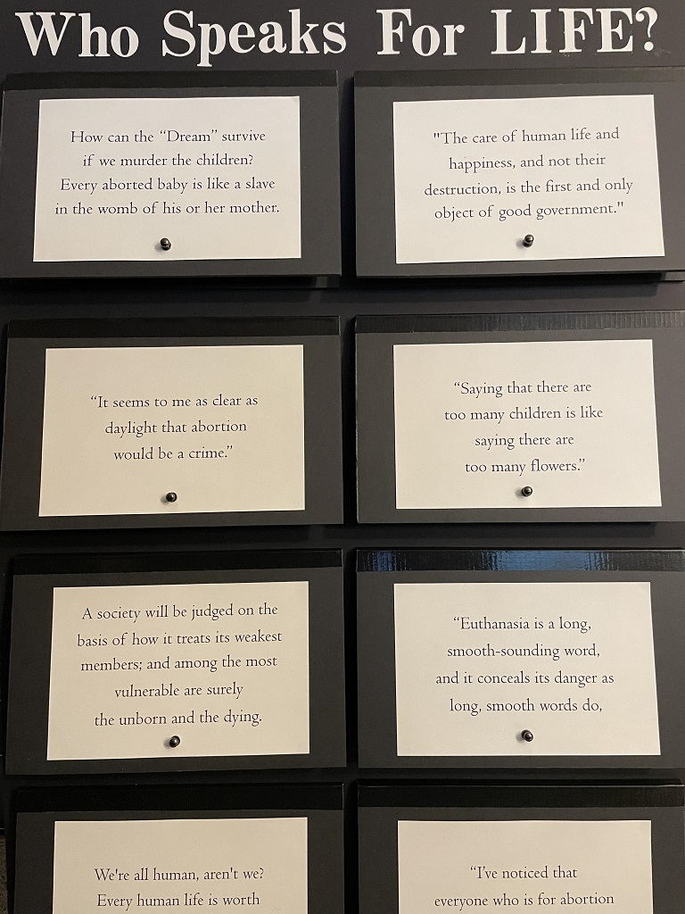
WHO SPEAKS
FOR LIFE?

Slide 33
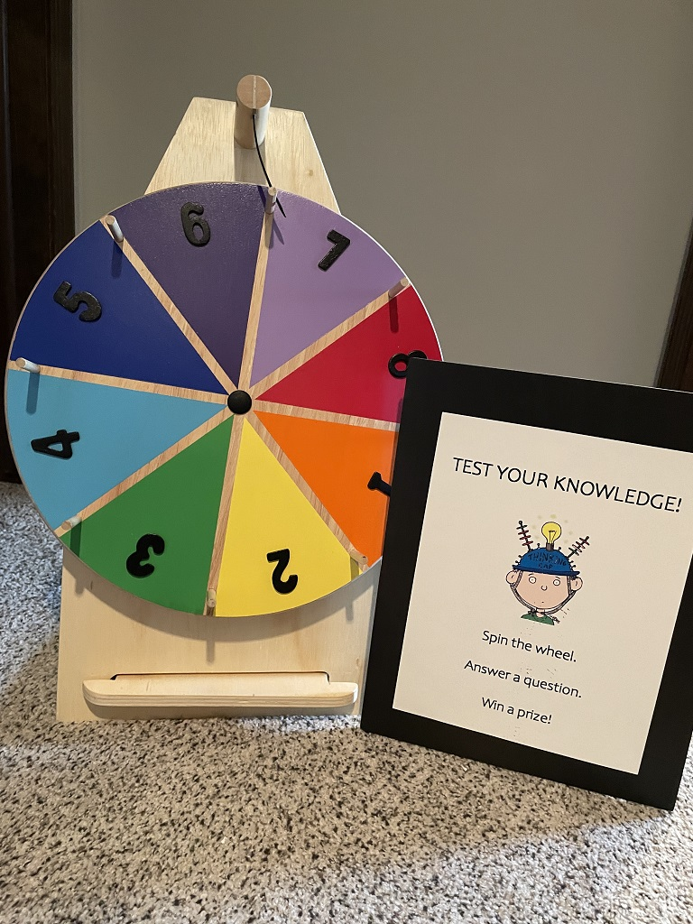
TEST
YOUR
KNOWLEDGE!

Slide 34
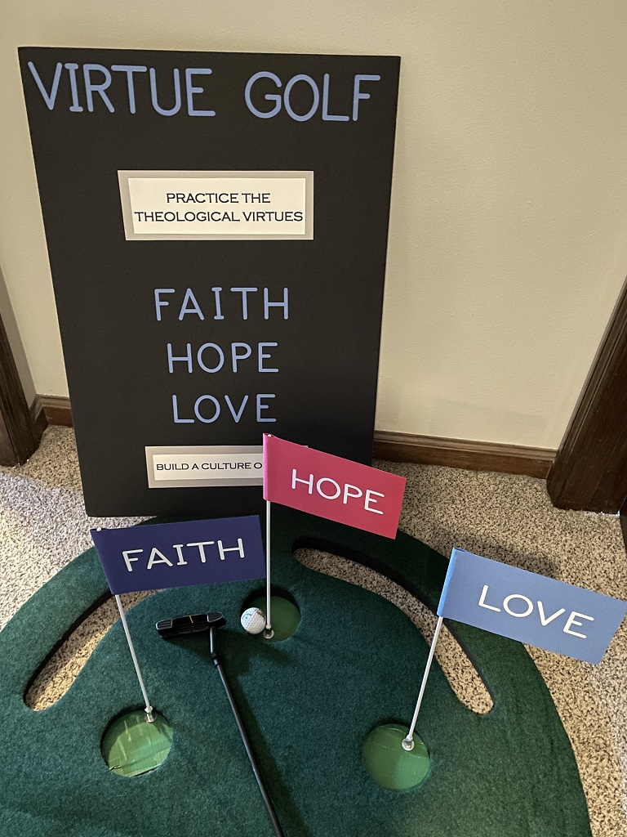
VIRTUE GOLF

Slide 35
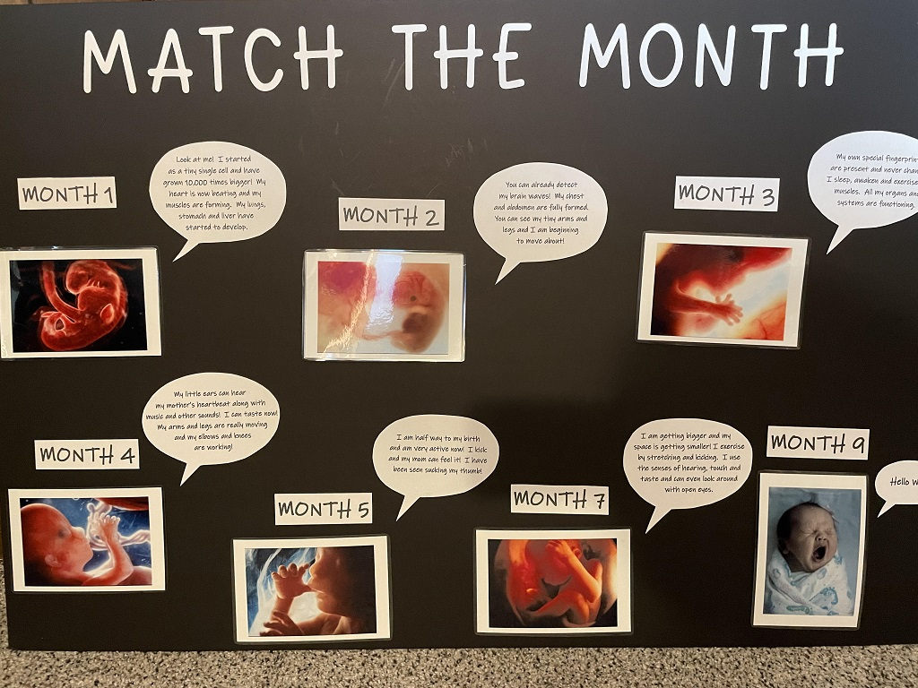
MATCH
THE
MONTH

Slide 36
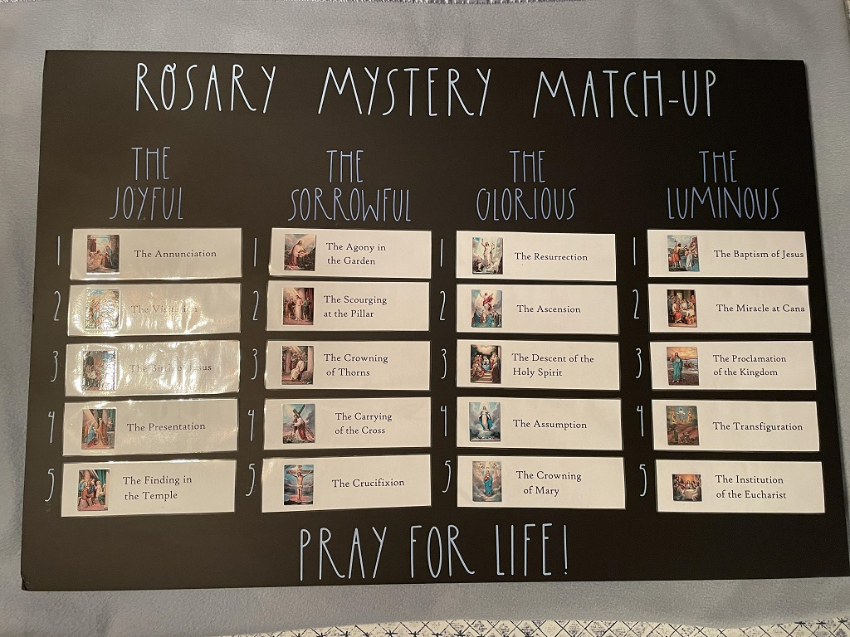
ROSARY
MYSTERY
MATCH-UP

Slide 37
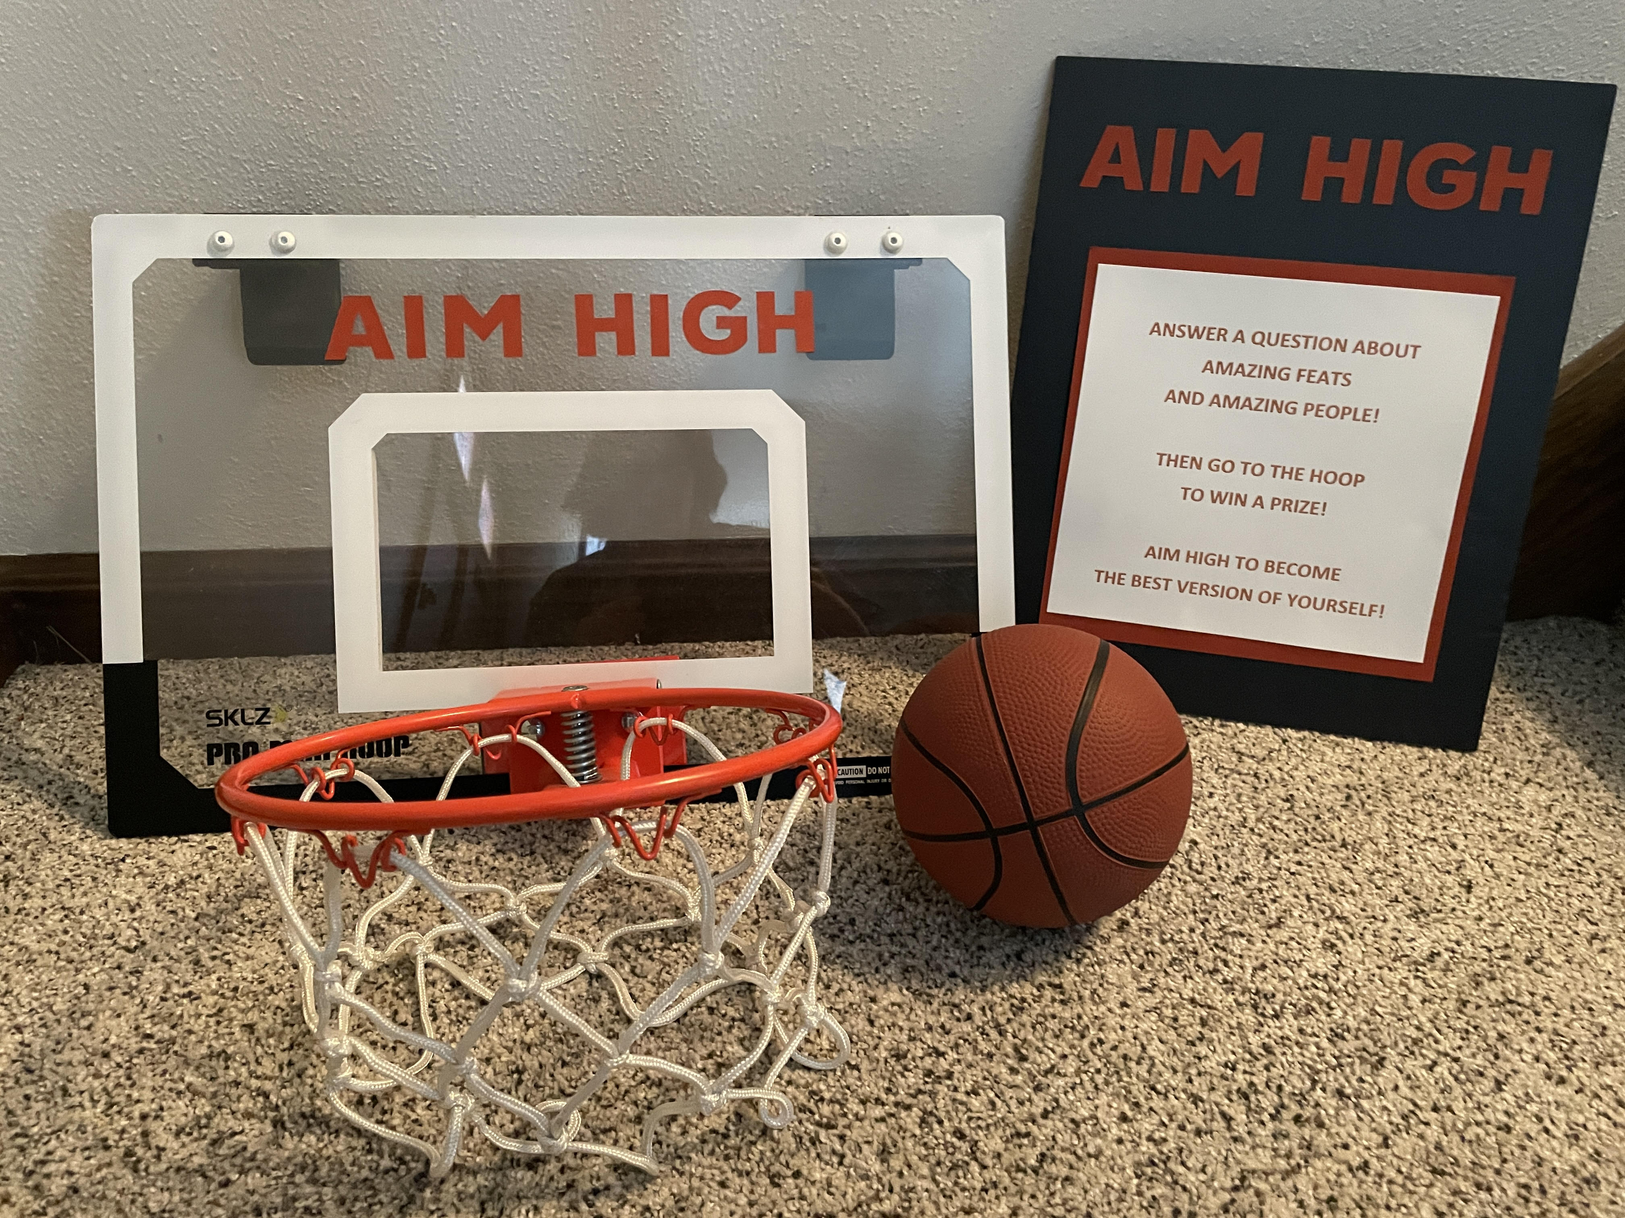
AIM HIGH

Slide 38
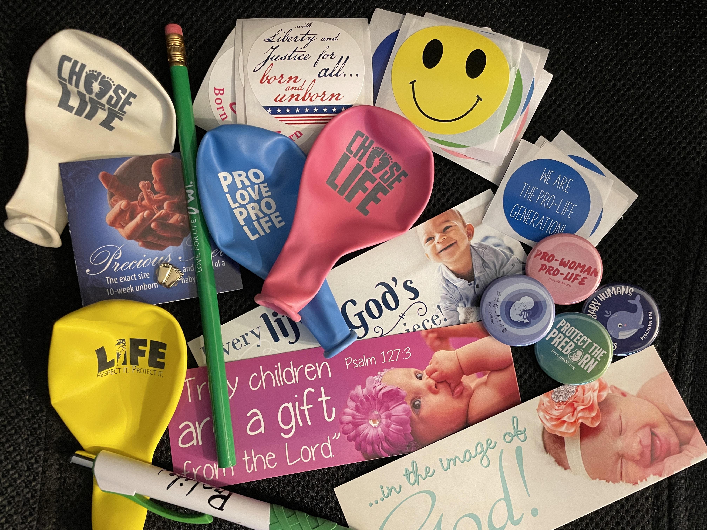
PRIZES GIVE-AWAYS

Slide 39
THOUGHTS?
Questions?
Contact Information
Kathy Easter 262-366-9585
prolifefair.com

